Slide 1
EI-331 Design and Analysis of Algorithms

Slide 2
EI-331 Design & Analysis of Algorithms String Matching
String matching is a fundamental problem in computer science, with applications in various fields including text processing, bioinformatics, and data retrieval.
It involves finding occurrences of a substring (pattern) within a larger string (text).
String matching algorithms aim to efficiently locate these occurrences.

Slide 3
EI-331 Design & Analysis of Algorithms String Matching
Text: The larger string in which we want to find occurrences of a smaller string (pattern).
Pattern: The smaller string we are searching for within the text.
Occurrence: A position in the text where an exact match of the pattern is found.

Slide 4
EI-331 Design & Analysis of Algorithms String Matching
Naive String Matching Algorithm – Brute-Force Algorithm
The simplest approach to string matching.
Iterate through the text one character at a time and compare it with the pattern.
If a match is found, check if the subsequent characters also match the pattern.
Complexity: O((n-m+1)*m) where n is the length of the text and m is the length of the pattern.

Slide 5
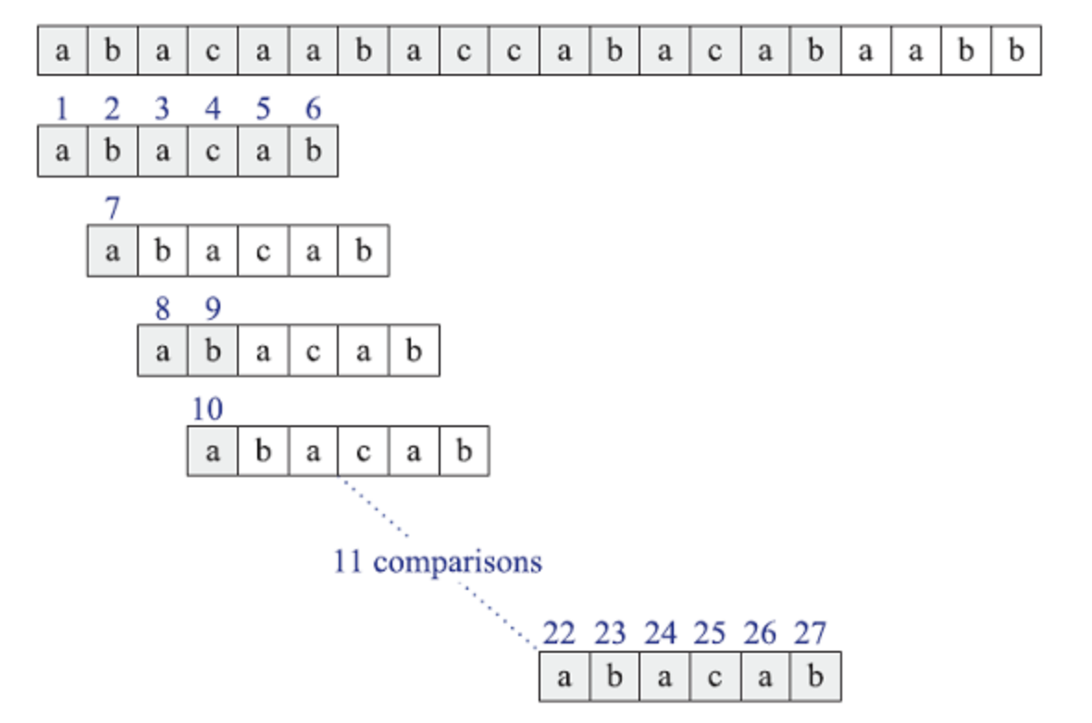
EI-331 Design & Analysis of Algorithms String Matching (Brute – Force Algorithm)

Slide 6
EI-331 Design & Analysis of Algorithms String Matching
Knuth-Morris-Pratt (KMP) Algorithm
Efficient string matching algorithm based on the concept of "failure function" or "prefix function".
Preprocess the pattern to determine the longest proper prefix of the pattern that is also a suffix.
Use this information to avoid unnecessary comparisons in the text.
Complexity: O(n + m), where n is the length of the text and m is the length of the pattern.

Slide 7
EI-331 Design & Analysis of Algorithms String Matching (Knuth-Morris-Pratt (KMP) Algorithm)
j | 0 | 1 | 2 | 3 | 4 | 5
P[j] | a | b | a | c | a | b
F(j) | 0 | 0 | 1 | 0 | 1 | 2

Slide 8
EI-331 Design & Analysis of Algorithms String Matching
Knuth-Morris-Pratt (KMP) Algorithm
Preprocess the pattern to compute the failure function.
Use the failure function to guide the search in the text.
Achieves linear time complexity.

Slide 9
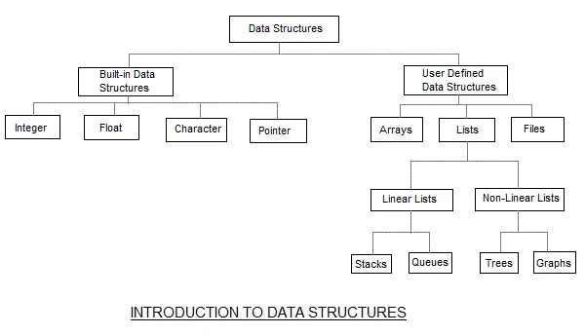
EI-331 Design & Analysis of Algorithms Data Structure Revision

Slide 10
EI-331 Design & Analysis of Algorithms Graphs
A graph is a data structure composed of nodes (vertices) and edges that connect pairs of nodes.
Nodes represent entities, and edges represent relationships between these entities.
Graphs are versatile and widely used in various fields, including computer science, social networks, transportation systems, and more.

Slide 11
EI-331 Design & Analysis of Algorithms Graphs
The basic properties of a graph include:
Vertices (nodes): The points where edges meet in a graph are known as vertices or nodes. A vertex can represent a physical object, concept, or abstract entity.
Edges: The connections between vertices are known as edges. They can be undirected (bidirectional) or directed (unidirectional).
Weight: A weight can be assigned to an edge, representing the cost or distance between two vertices. A weighted graph is a graph where the edges have weights.
Degree: The degree of a vertex is the number of edges that connect to it. In a directed graph, the in-degree of a vertex is the number of edges that point to it, and the out-degree is the number of edges that start from it.
Path: A path is a sequence of vertices that are connected by edges. A simple path does not contain any repeated vertices or edges.
Cycle: A cycle is a path that starts and ends at the same vertex. A simple cycle does not contain any repeated vertices or edges.
Connectedness: A graph is said to be connected if there is a path between any two vertices. A disconnected graph is a graph that is not connected.

Slide 12
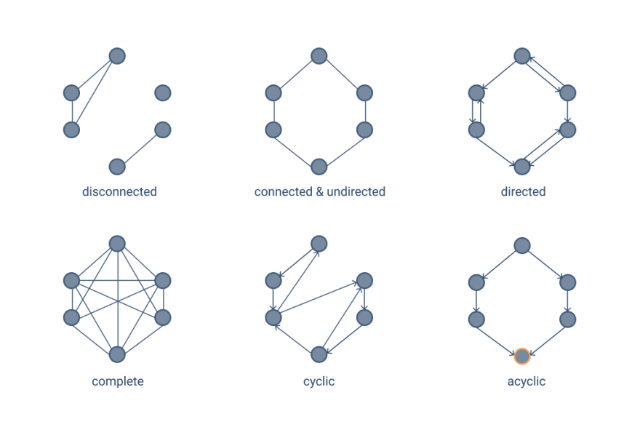
EI-331 Design & Analysis of Algorithms Graphs

Slide 13
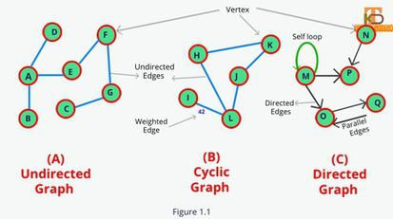
EI-331 Design & Analysis of Algorithms Graphs

Slide 14
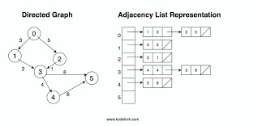
EI-331 Design & Analysis of Algorithms Graphs Representation

Slide 15
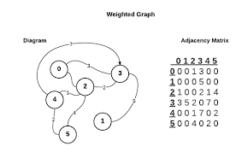
EI-331 Design & Analysis of Algorithms Graphs Representation

Slide 16
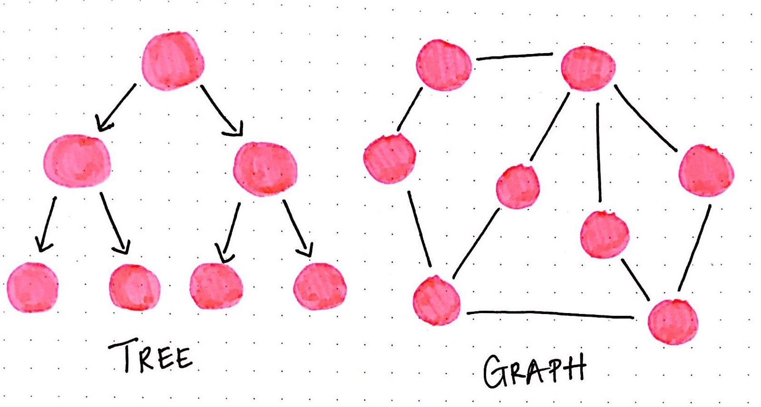
EI-331 Design & Analysis of Algorithms Tree vs Graphs

Slide 17
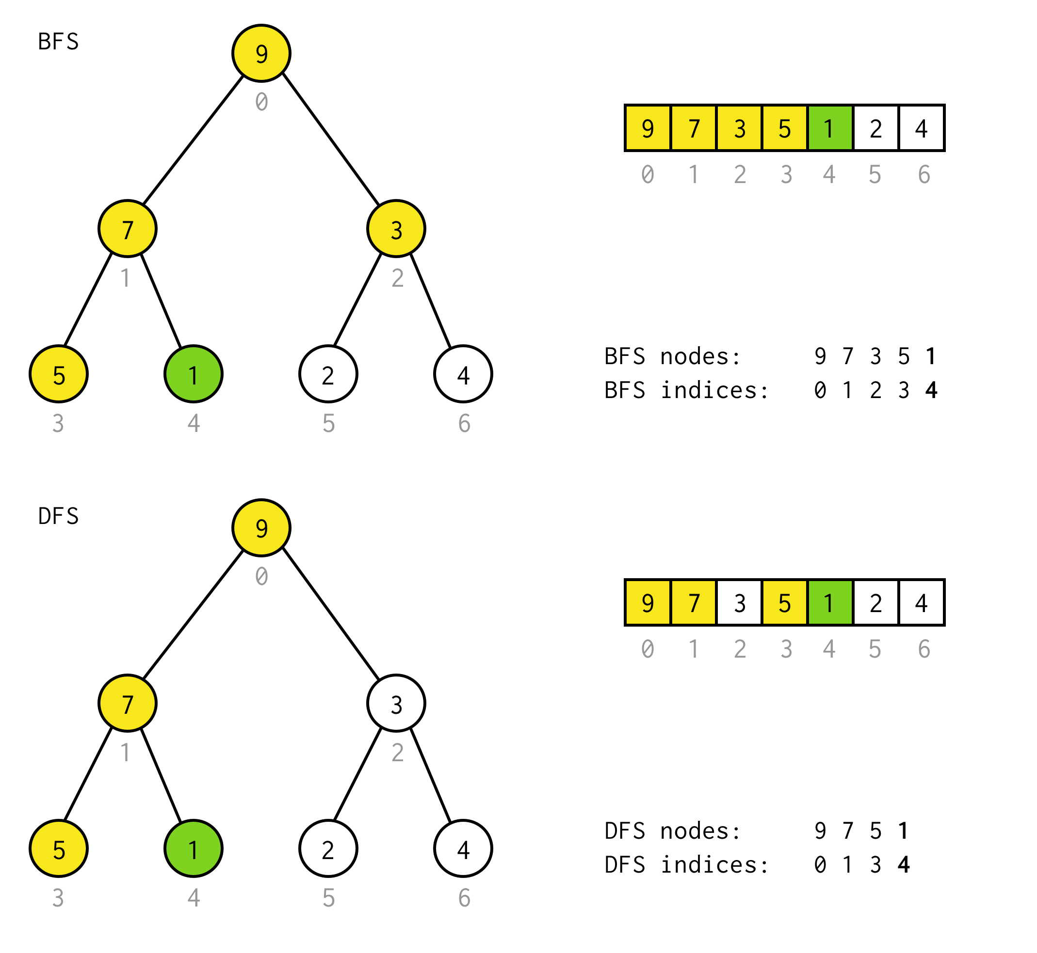
EI-331 Design & Analysis of Algorithms Graphs Search

Slide 18
EI-331 Design & Analysis of Algorithms Graphs Search

